Slide 1
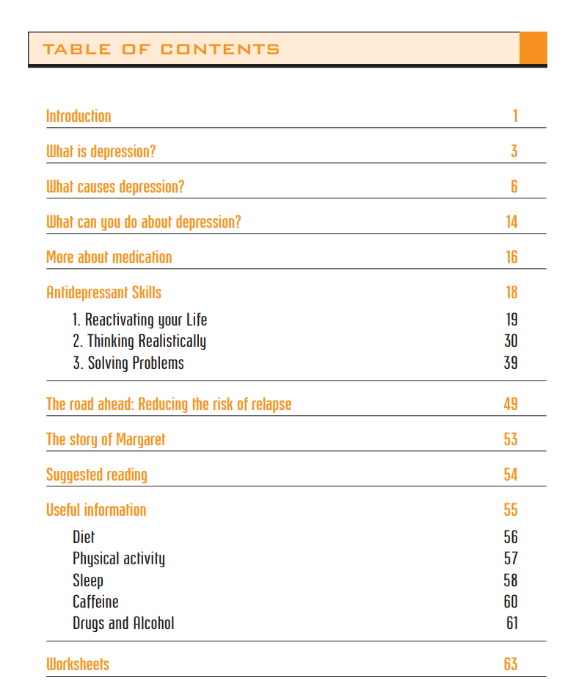
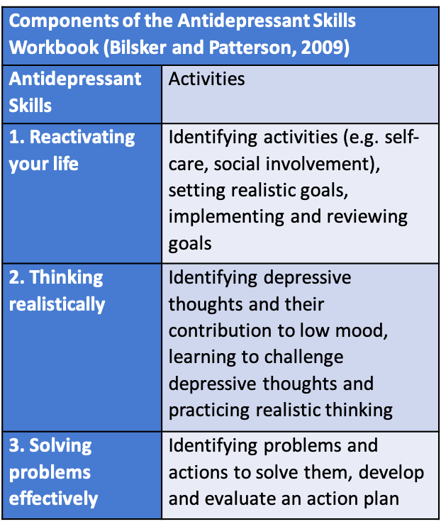
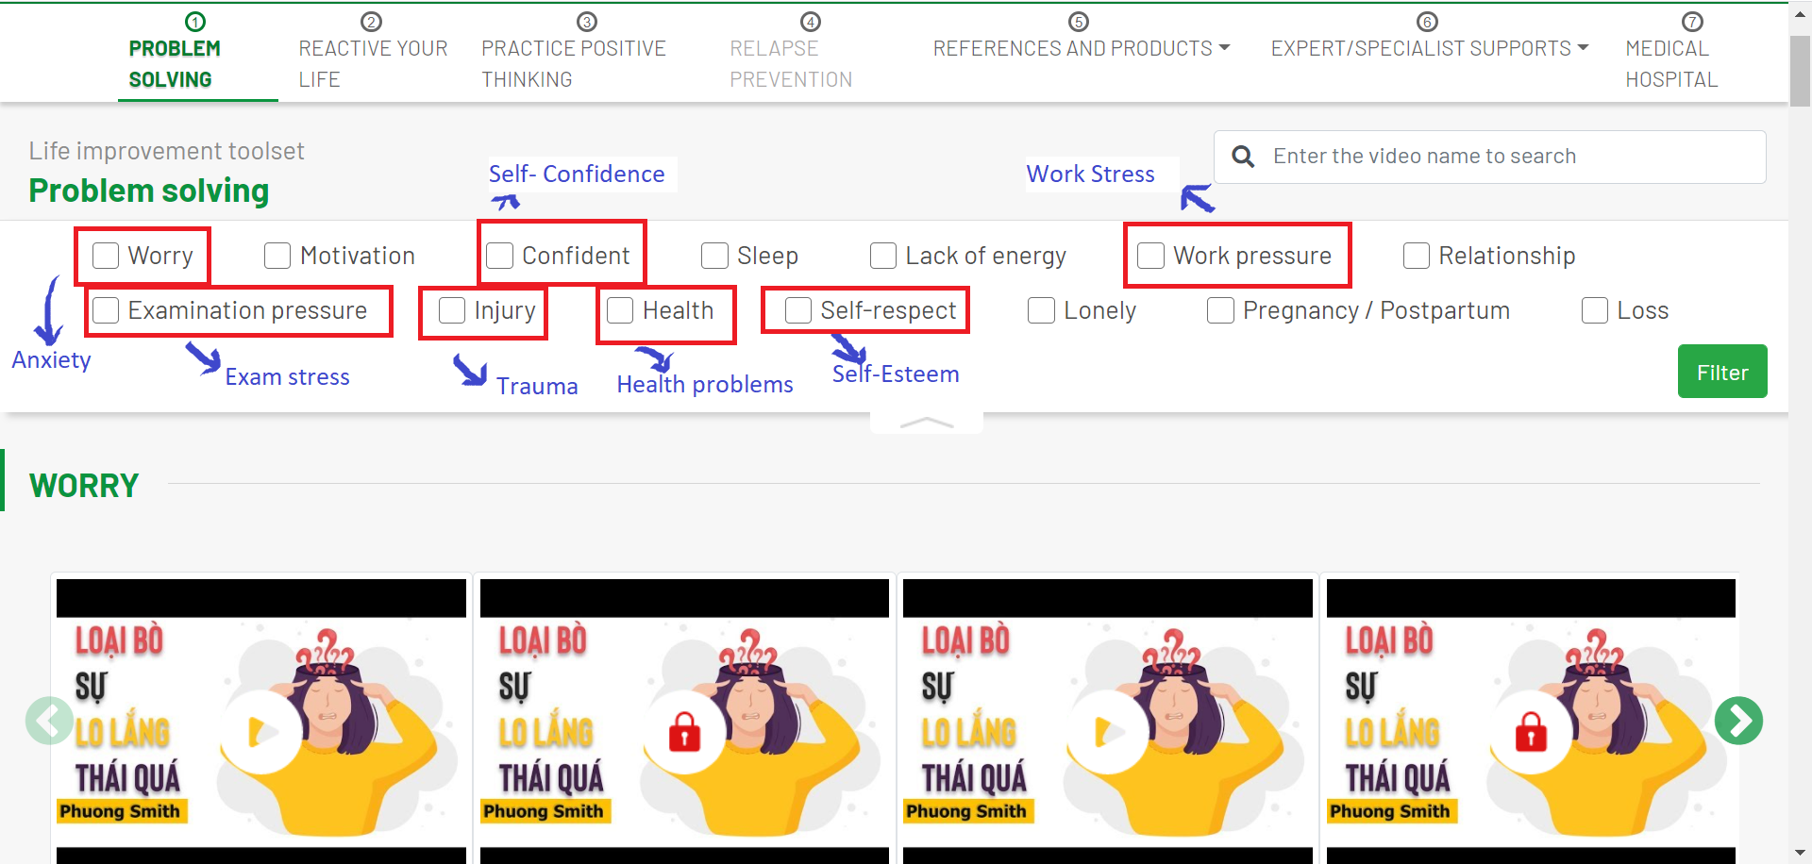
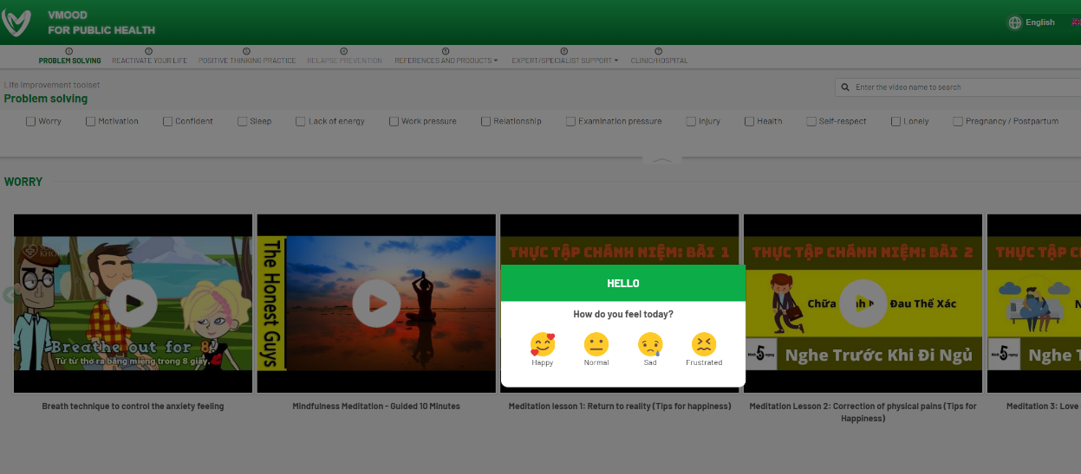
VMood: Adaptation of an In-person Depression Intervention to a Smartphone App
Leena Chau¹, Vu Cong Nguyen², Viet Anh Duong², Hayami Lou¹, John O’Neil¹
¹Faculty of Health Sciences, Simon Fraser University, ²Institute of Population, Health and Development (Vietnam)
Introduction
Figure 1: Antidepressant Skills Workbook Components
Figure 4: VMood Screen Grab – Problem Solving
Depression is a pressing issue in Vietnam. Prevalence varies from 5-19.5% in different populations. Community-based depression care has historically been limited.
Supported Self-Management (SSM) is a low-cost community-based depression intervention grounded in principles of Cognitive Behavioural Therapy. Patients are given an Antidepressant Skills Workbook (ASW) and receive supportive coaching from social workers. SSM was developed in Canada and shown to be effective in Vietnam in an RCT (funded by Grand Challenges Canada). In response to the Government of Vietnam’s request to adapt SSM to a more scalable mHealth format, our team developed VMood, a Smartphone app.
Results
Student users emphasized VMood’s ease of download and activation, and rated it high on usability. They appreciated the design of VMood (colours and fonts) and found it straightforward to use, including for setup, and logging in and out.
They identified 12 bugs related to the sign-in page, loading issues with the screening tool (PHQ-9), reactivate your life skills page, references and products page, and issues with the notify your social worker function. (Note as this was beta testing, no providers were involved).
All bugs have been fixed in the updated version.
Objective
Figure 2: VMood Landing Page
To describe the adaptation process of the in-person SSM intervention to a mobile app format (VMood) and present findings from the beta testing.
Methods
SSM was adapted to an app format in Vietnam through an iterative process. Led by team members in Vietnam, a prototype was developed informed by findings from a literature review ensuring best practices and intervention fidelity adapting in-person interventions to mHealth. VMood is available in Vietnamese and English.
App functionality reflects the structure and process of the in-person SSM. It includes depression management functions from the ASW and access to support from a social worker through a chat function.
Beta testing involving the 5 users has been completed. Feedback was gathered by emailed surveys accompanied by screenshots.
Conclusions
Figure 3: VMood Request Social Worker Support Page
Beta testing demonstrated VMood’s usability and appropriateness in community settings.
The adaptation and testing of VMood is timely given the increased urgency for mHealth solutions within the context of the COVID-19 pandemic.
The research team will be piloting the updated version of VMood in an RCT in 8 provinces in Vietnam. Additional feasibility testing in various geographic, cultural and sociodemographic situations in Vietnam (e.g., in industrial zones) will also be conducted to determine its effectiveness. Funding from CIHR and Grand Challenges Canada will support this work.
Notes:
Min size font = 36 (0.5 inch)
Be sure to highlight how this study contributes to the body of literature on this topic Highlight how this study appeals to an international audience

