Slide 1
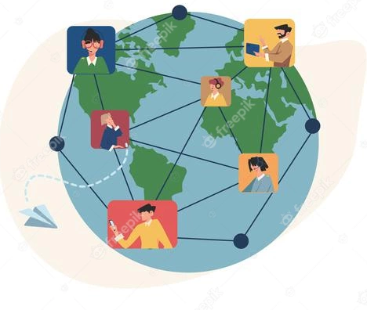
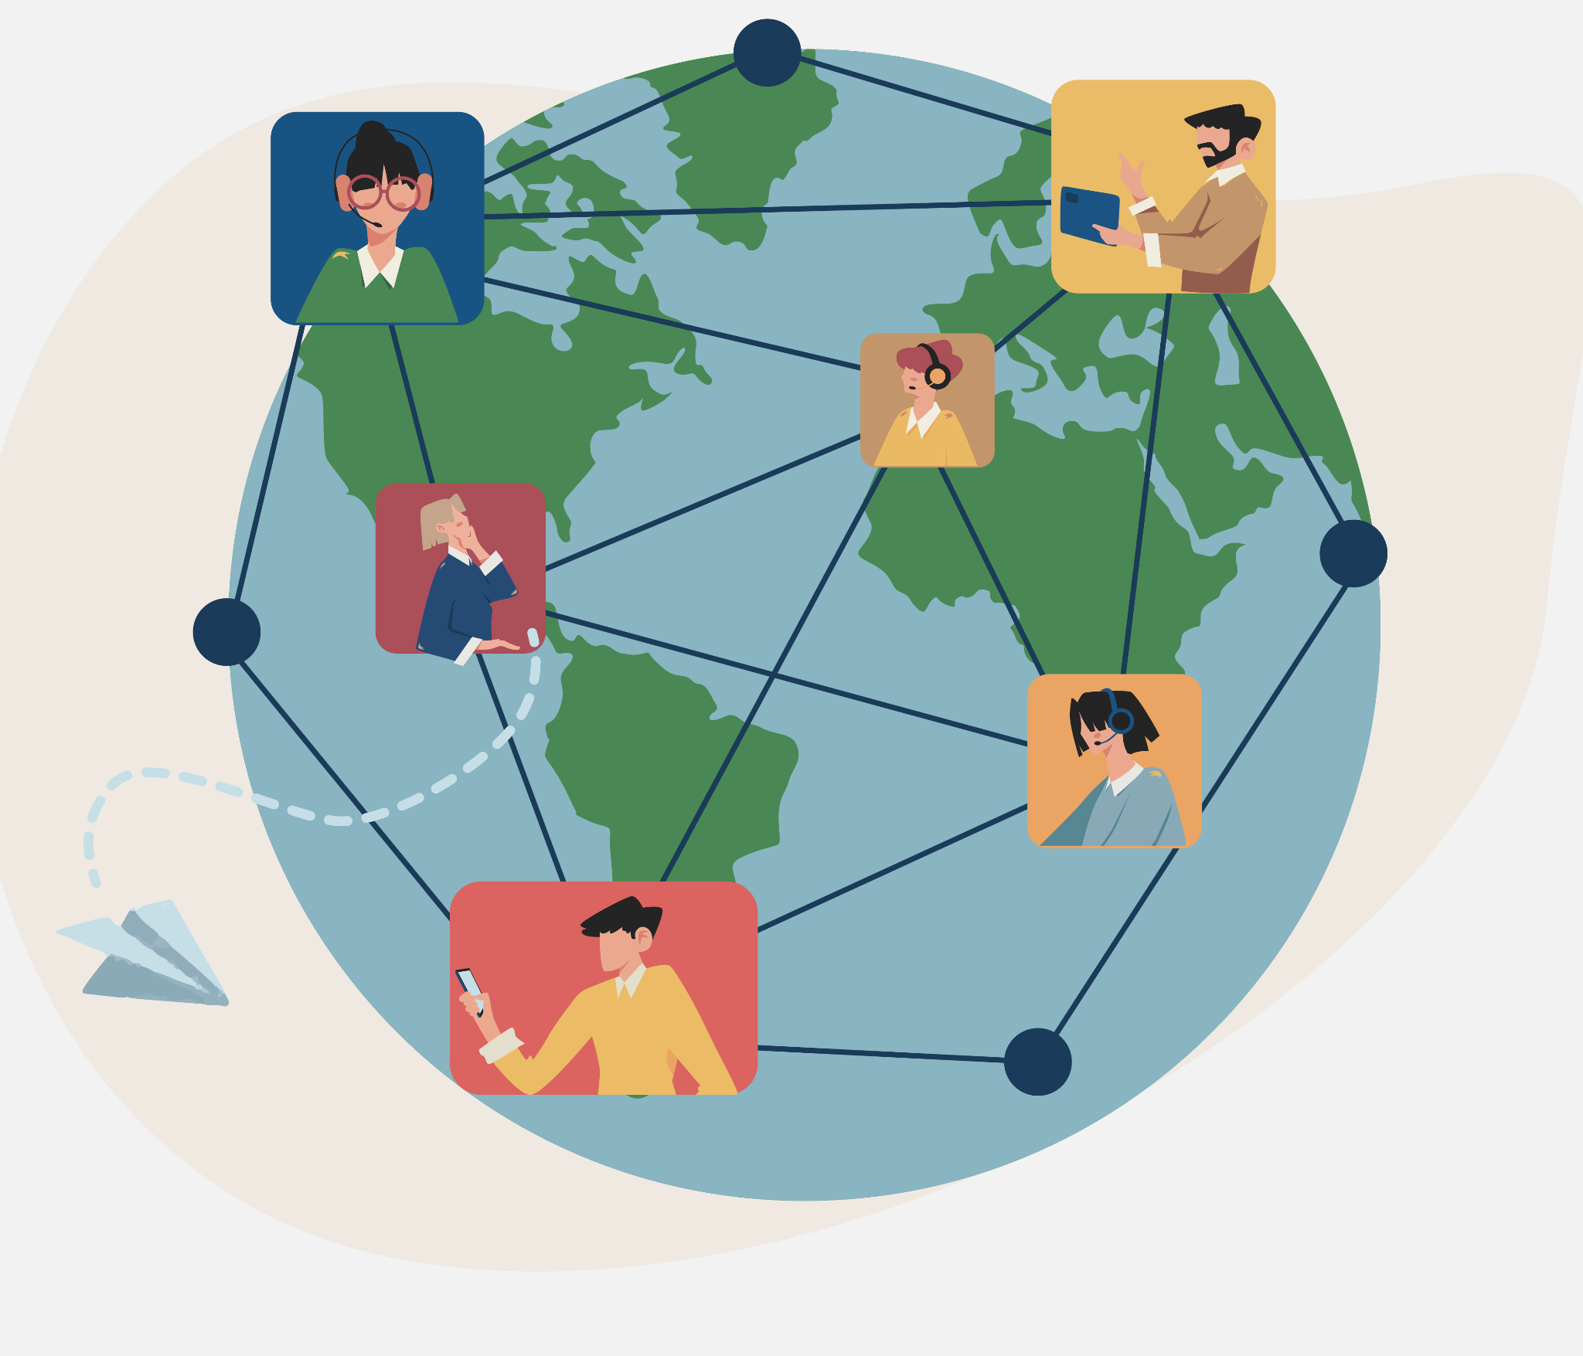
Strengths and challenges of virtual community-based participatory research: takeaways from a bipolar disorder mHealth project
Laura Lapadat, Emma Morton, Erin E. Michalak, CREST.BD
CREST.BD, Department of Psychiatry, University of British Columbia
Introduction
To ensure mental health interventions are acceptable and engaging, it is critical to involve all relevant stakeholders, including clinicians, community members, and people with lived experience. Virtual community-based participatory research (CBPR) holds potential to advance the equitable involvement of diverse stakeholders in global mental health initiatives. The shift to virtual CBPR during the COVID-19 pandemic represents a key opportunity to evaluate the feasibility of such methods.
Here, we present a case study describing use of a virtual CBPR framework to develop an mHealth intervention for bipolar disorder, with a specific focus on peer researchers' co-creation of short, affirmational messages for app users.
Methods
Informed by a decade of research, the CREST.BD network has formulated a strengths-based CBPR model that involves peer researchers with bipolar disorder in each stage of research. In line with this model, peer researchers were invited to co-author short, affirmational messages drawing on both the research evidence and their lived experience.
Peer researchers (N=5) from across Canada were recruited. Compensation of $25 per hour was provided.
Collaboration occurred entirely online. Writing took place in Google Sheets. Confidentiality was protected by enabling anonymous collaboration, limiting access to the document, and using initials instead of names. Group communication was facilitated by email and Zoom meetings.
1,582 affirmations were written between March and July 2021.
Virtual community-based participatory research is an enabler of cross-regional collaboration.
Results
A major strength to the asynchronous nature of online collaboration was the flexibility it afforded peer researchers, who could work on preferred schedules, around potential bipolar disorder symptoms, and from across Canada. Though collaboration was largely asynchronous, a communal group atmosphere was established through group meetings and activities over Zoom.
Although the use of virtual methods supported involvement of people who may otherwise have faced barriers to participation, competing priorities and health concerns still presented challenges to peer researcher engagement. 3 of the 5 researchers were unable to participate for the full duration of the co-wri ting process.
Use of collaborative software made it possible to view progress in real-time. This helped identify when peer researchers required additional support. Roles were then iteratively adjusted based on the individual strengths of peer researchers, which facilitated timely project completion.
Conclusion
Virtual CBPR can enhance equity in global mental health research by decentralizing collaboration and presenting opportunities to involve seldom-heard stakeholders. Here, virtual methods increased participation of traditionally difficult-to-reach groups. However, some barriers persisted in an online format. Future research is require to preserve the benefits of virtual collaboration for cross-regional mental health projects while addressing the challenges of asynchronous communication.
References
Tami-Muary et al., 2017, J Commun Health 10: 188–194.
Valdez E & Gubrium A., 2020, Interntl Journal of Qual Methods 19: 1-9.
Michalak EE et al., 2015, Engaged Scholar Journal 1: 132-147.
Collaborative software can help mitigate some of the challenges of virtual community engagement.
Notes:
1
https://www.tamarackcommunity.ca/library/the-engagement-continuum

